Slide 1
A Cashless Society + Big Data + AI
Panel Discussion

Slide 2
Big Data
Actuaries are the data scientists of insurance
Using data for pricing, reserving, risk management etc.
New emerging trends in insurance
Technological advances
Mass data collection and storage (eg. cloud)
CCTV, mobile networks and wearables
Track your customers
Online, real-time, all-the-time
Social Media Networks
Third-Party Data Augmentation (eg. Mosaic)

Slide 3
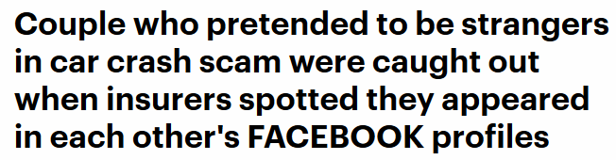
Big Data
Examples
All John Hancock life insurance will come with Vitality [1]
Incentivise healthy behaviour – physical activity, nutrition
Use of Telematics in Motor Insurance
Incentivise safer driving [2]
Allows for usage-based insurance and meet new business models and regulation – Grab Daily e-Hailing Insurance [2] [3]
Insurance Fraud detection [4]

Slide 4
Big Data + AI
Availability of large data sets and computation power
Cloud computing, GPUs
Advancement in machine learning and artificial intelligence
Deep Learning, agent-based systems
Automation and digitisation
Examples
Improvement to regression models (eg. mortality rates)
Propensity models predicting which customers are most likely to buy a product or repurchase from a company
Real-time underwriting

Slide 5
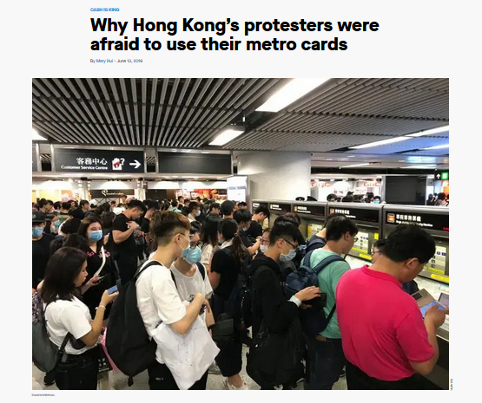

Cashless Society + Big Data + AI
Surveillance Capitalism
Ref [5]

Slide 6

Cashless Society + Big Data + AI
What about discrimination, financial exclusion and abuse of data?
Role of Financial Services Firms
Address the needs of the under-served (eg. unbanked and uninsured)
Needs of foreigners – tourists, foreign workers
Model validation and governance
Ref [11]

Slide 7
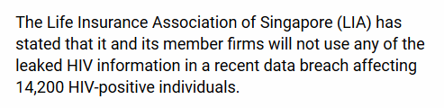
Cashless Society + Big Data + AI
Role of the Industry / Marketplace
Some evidence that autonomous pricing algorithms may learn to collude by trial and error [12]
Without communicating with one another
Not specifically designed or instructed to collude
Role of Professional Bodies
“A Guide for Ethical Data Science” – Collaboration between the Royal Statistical Society and IFoA
Ref [9]

Slide 8
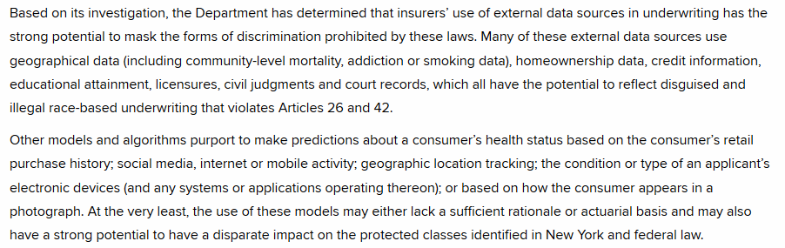
Cashless Society + Big Data + AI
Role of the Government / Regulator
Address the needs of foreigners, especially for public services, GDPR
Regulate and monitor the use of data and AI in corporations
NYC Dept of Financial Services
Ref [10]

Slide 9
Cashless Society + Big Data + AI
Role of Customer
Be aware of your rights as a consumer and how your data is used/shared
Be aware of how you are being tracked online and offline
Remove your data from various platforms
Select service providers which do not track you online
If It’s free, then
you
are the product.

Slide 10
References
[1] John Hancock Leaves Traditional Life Insurance Model Behind to Incentivize Longer, Healthier Lives, Cision PR Newswire, 19 Sep 2018
Accessed 24 Nov 2019: https://www.prnewswire.com/news-releases/john-hancock-leaves-traditional-life-insurance-model-behind-to-incentivize-longer-healthier-lives-300715351.html
[2] Alicja Grzadkowska, What is usage-based insurance?, Insurance Business UK, 19 Nov 2018
Accessed 24 Nov 2019: https://www.insurancebusinessmag.com/uk/guides/what-is-usagebased-insurance-116604.aspx
[3] Grab Daily e-Hailing Insurance
Accessed 24 Nov 2019: https://www.grab.com/my/daily-insurance/
[4] Sonya Mclean, Couple who pretended to be strangers in car crash scam were caught out when insurers spotted they appeared in each other's FACEBOOK profiles, Irish Daily Mail, 26 Nov 2015
Accessed 24 Nov 2019: https://www.dailymail.co.uk/news/article-3334803/Facebook-foils-couple-s-scheme-claim-insurance-car-crash.html

Slide 11
References
[5] Mary Hui, Why Hong Kong’s protesters were afraid to use their metro cards, Quartz, 30 May 2019
Accessed 24 Nov 2019: https://www.straitstimes.com/business/companies-markets/airasia-in-talks-to-build-mobile-app-that-will-sell-more-than-plane
[6] Straits Times, AirAsia in talks to build mobile app that will sell more than plane tickets, 27 Feb 2018
Accessed 24 Nov 2019: https://www.allianz.com/en/press/news/business/insurance/180227-allianz-visa-launch-mobile-payment-and-loyalty-app.html
[7] CNBC, AirAsia CEO says its mobile payment app will give Alipay, GrabPay ‘a run for their money’, 6 Nov 2018
Accessed 24 Nov 2019: https://www.cnbc.com/2018/11/06/airasia-ceo-bigpay-can-give-alipay-grabpay-a-run-for-their-money.html
[8] Allianz, Allianz and Visa launch mobile payment and loyalty app , 27 Feb 2018
Accessed 24 Nov 2019: https://www.allianz.com/en/press/news/business/insurance/180227-allianz-visa-launch-mobile-payment-and-loyalty-app.html

Slide 12
References
[9] Gabriel Olano, Singapore insurers to keep their hands off leaked HIV information, 2 Feb 2018
Accessed 24 Nov 2019: https://www.insurancebusinessmag.com/asia/news/breaking-news/singapore-insurers-to-keep-their-hands-off-leaked-hiv-information-123846.aspx
[10] New York State – Department of Financial Services, RE: Use of External Consumer Data and Information Sources in Underwriting for Life Insurance, Insurance Circular Letter No. 1 (2019), 18 Jan 2019
Accessed 24 Nov 2019: https://www.dfs.ny.gov/industry_guidance/circular_letters/cl2019_01
[11] Bank of England and Financial Conduct Authority, Machine Learning in UK Financial Services, Oct 2019
Accessed 24 Nov 2019: https://www.dfs.ny.gov/industry_guidance/circular_letters/cl2019_01
[12] Calvano E. et al., Artificial intelligence, algorithmic pricing, and collusion, 3 Feb 2019
Accessed 24 Nov 2019: https://www.dfs.ny.gov/industry_guidance/circular_letters/cl2019_01

